Slide 1
Welcome To GE Vernova Proficy update

Slide 2
Safe Harbor Disclaimer
The information presented is intended to be an outline of general product direction and it should not be relied on in making a purchasing decision. The information on the roadmap is for information purposes only and may not be incorporated into any contract and is not a commitment, promise or legal obligation to deliver any material, code, or functionality. The development, release, and timing of any features or functionality described for our products remains at our sole discretion.
This contains GE proprietary information, and the recipient is not authorized to disclose such information to third parties
2
Notes:
The event today may include forward-looking statements. The information presented is intended to be an outline of general product direction and it should not be relied on in making a purchasing decision.

Slide 3
We are
© 2024 GE Vernova and/or its affiliates. All rights reserved.
GE and the GE Monogram are trademarks of General Electric Company
used under trademark license.
Notes:
With over 130 years of innovation on April 2024 GE completed it transformation to 3 publicly traded companies. GE Aerospace, GE Healthcare and GE Vernova.
We are GE Vernova an 80K strong employee co. the mission is embedded in its name – it retains its legacy, “GE,” as an enduring and hard-earned badge of quality and ingenuity. “Ver” / “verde” signal Earth’s verdant and lush ecosystems. “Nova,” from the Latin “novus,” nods to a new, innovative era of lower carbon energy. We are focused primarily on energy and utilities.

Slide 4
Only software can solve the complexity, manage interconnected systems, leverage data at exponential scale and make optimal real-time decisions under uncertainty
Notes:
But as we know the Electrician and Decarbonization environment continues to build in complexity. A multitude of generation sources, a bi-directional grid, ever business critical expenses associated with consumption and of course all this while the planet and its people are in desperate need of decarbonization….It is our belief that it can only be achieved with software.
We make software that helps in the Manufacturing, energy and utilities space

Slide 5
Accelerators
Accelerate your innovation.
Empower your team.
Drive your future.
Notes:
Accelerators we are focused on: How can our software help accelerate innovation for you as our customers, how can we empower your team to make the right decisions to be more efficient and how can we enable you drive any future plans whether it is transformation, modernization

Slide 6
Proficy Strategy & Roadmap

Slide 7
“Deliver the only fully integrated plant software suite with a core data fabric that enables enterprise-wide production optimization from the equipment to the ERP”
© 2025 GE Vernova and/or its affiliates. All rights reserved.
GE and the GE Monogram are trademarks of General Electric Company used under trademark license.
Notes:
The entire plant software system right from connectivity to control systems, SCADA, Historian MES- our goal is to be the only fully integrated plant software suite that works with the core data fabric…..

Slide 8
GE Vernova – Proficy® Software Enabling the Smart Factory & Infrastructure
Other IT Systems
(ERP, EAM, PLM, …)
Proficy Investment Strategy…
Fully integrated manufacturing management platform, simplifies digital transformation of the plant floor and enterprise
Digital Operations combined with Process and Planning Optimization to drive production optimization
Simplified integration between the Proficy suite, OT data sources and IT systems freeing trapped & siloed production data and enabling new insights
A modernized tech stack that aligns to the 24x7x365 manufacturing reality … always on and always up to date
Rapidly deploy anywhere: on-premises, customer cloud infrastructure, or SaaS … aligned with your IT vision
Proficy Scheduler
Proficy MES
Proficy Historian
Proficy CSense Analytics
Proficy Operations Hub
Proficy for Sustainability Insights
Proficy HMI/SCADA
iFIX & CIMPLICITY
Control Systems
Notes:
In a classic Purdue model, if we stack our capabilities, we start with the HMI/SCADA(iFix/Cimp) and move onto the energy monitoring and optimization with Sustainability insights, onto data archiving in the Historian to MES and then tools to optimize production plant and then finally into systems like ERP, etc. in support of these core capabilities we have a single visualization tool in Operations Hub that goes across these layers. Then we have a set of out of the box analytics that are shipped with SCADA and the Historians.Our investment strategy is to ..

Slide 9
GE Vernova – Proficy® Software Enabling the Smart Factory & Infrastructure
Complementary Solutions
Other IT Systems
(ERP, EAM, PLM, …)
Doc Mgmt
QMS
IMS
WMS
Assembly Operations
Batch Records
W&D
Proficy Scheduler
Proficy MES
Proficy Data Hub
Enterprise model | Unified namespace | Message bus
Proficy Historian
Unified & Extensible UI/UX
Proficy CSense Analytics
Proficy Operations Hub
Containerized & Zero Trust Security
Proficy for Sustainability Insights
Enterprise Data Fabric
Proficy HMI/SCADA
iFIX & CIMPLICITY
Infrastructure: Cloud, On-Premises, Edge
Hybrid Cloud Infrastructure
Control Systems
UNDER DEVELOPMENT
THIRD-PARTY
Notes:
Here we want to highlight where we are going, we are thinking that we transition from this layer by layer approach based on capabilities into a more homogenous, integrated portfolio of capabilities powered by Data Hub- a common data fabric that goes all across our products- that is the unifying platform, so when you refer to a pump in an operation, it is the same pump in the Scada v/s Historian vs when running an analytic- we want to drive the common model context instead of defining it 3 different times. A common unifying factor in the way data is exchanged and consumed across

Slide 10
Proficy powered by Data Hub
Data Model
Create hierarchical relationships between object types in the directory. Deploy to Proficy applications
3rd Party
Complementary Solutions
Plug & Play customer & partner solutions
Operations Data & Applications Model – Enterprise scale
UNIFIED NAMESPACE
Adds context to Objects in the Model by consolidating data from heterogeneous sources into a single element & timestamp.
BMS
QMS
APS
IMS
WMS
Plug & Play Analytics & Optimization
Analytics
Schedule Optimization
Scheduler
Directory Service
Publish configuration, objects, variables and classes to a central directory that all products can consume.
Proficy
Applications MES
AI/ML-enabled, Composable, Scalable
MES
Quality | Traceability/Gen. | Efficiency | Process Analysis
Historian
Centralized Configuration, Management & Deployment
HMI/SCADA
Data Fabric
Provides access to data across all products. Minimize/eliminate replicated data access from multiple app. relying on the same data.
Configuration acceleration, Data Integration, Contextualization & Distribution
Data hub
Enterprise model | Unified namespace | Message bus
Unified & Extensible UI/UX
Containerized & Zero Trust Security
Infrastructure
Cloud, On-Prem, Edge
Hybrid Cloud Infrastructure
Notes:
4 different components: Data fabric/Data path- provides access to data, Dir service: publish config, objects etc to a central directory for products to consume, UNS to add context , and Model to organize the data in hierarchical relationships
Data Model-Common context for all Operational Assets that different IT/OT applications can associate with and single configuration for all Proficy data mapping. Standardization across different sites
Directory Service- Unified connections within Proficy and with variety of third-party applications/models needed for data democratization projects
Unified Namespace (UNS)- Single context to be used across Analytics, Optimization and Execution applications at a site and across different sites
Data Fabric- Simple, unified approach to exchanging data and plugging in applications needed for a total Operations Management solution

Slide 11
Proficy Platform Strategy
Cloud Transformation
Connected Worker
ProficyData Hub
Enterprise Scale
Sustainable Manufacturing
Simplifying digital transformation of the plant and enterprise
Notes:
We continue to invest heavily in our Proficy portfolio. The themes for our Proficy 2024 portfolio-wide release are:
Enterprise solutions – Focus on Enterprise Customers: centralized configuration & management / enterprise data & apps model
Cloud architectures: connect data/information islands, make data available across the enterprise, a single source of truth
Sustainability: GE is well positioned to help our customers reach their sustainability goals & we are enhancing our product offering to deliver more OOTB capabilities
Empower & Accelerate: Composable solutions to enable the Connected Worker
In addition to a preview of what’s coming near term and the strategy behind the 2024 portfolio release, we’ll also provide our long-term vision as well as key enablers for customer success & recent customer examples from around the world.
Our Proficy 2024 releases include major new versions of all our Proficy software:
Proficy Smart Factory MES
Proficy Historian & Historian for Cloud
Proficy Operations Hub
iFIX and CIMPLICITY HMI/SCADA
Proficy CSense & Proficy for Sustainability Insights (NEW)

Slide 12
Enterprise Scale
Vision
Easiest to deploy and manage suite of operations management software
Horizontal and Vertical scale of applications that grow with the customer need
Flexibility of deployment
2025
Enterprise System Management – Manage application & software deployments centrally
Near zero downtime Updates and Upgrades
Hyperscale cloud Historian
Proficy Data Hub enabled OT/IT integration
Notes:
Enterprise scale has 2 aspects 1) being able to process large amounts of data through a single server 2) being able to deploy a large number of solutions across geographical locations- we want to help with both and Enterprise system mgmt./centralized mgmt. is our vision to help with this

Slide 13
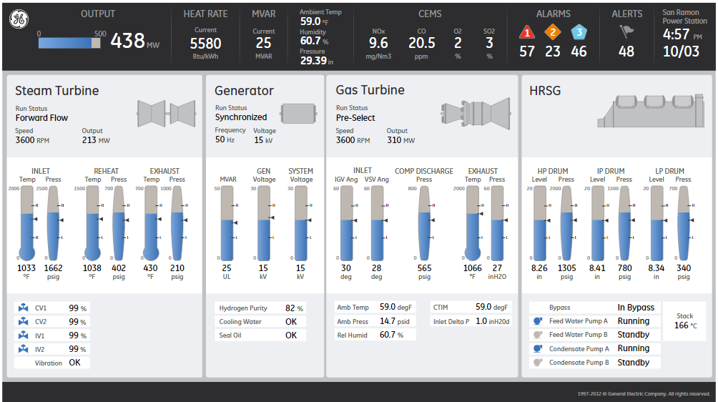
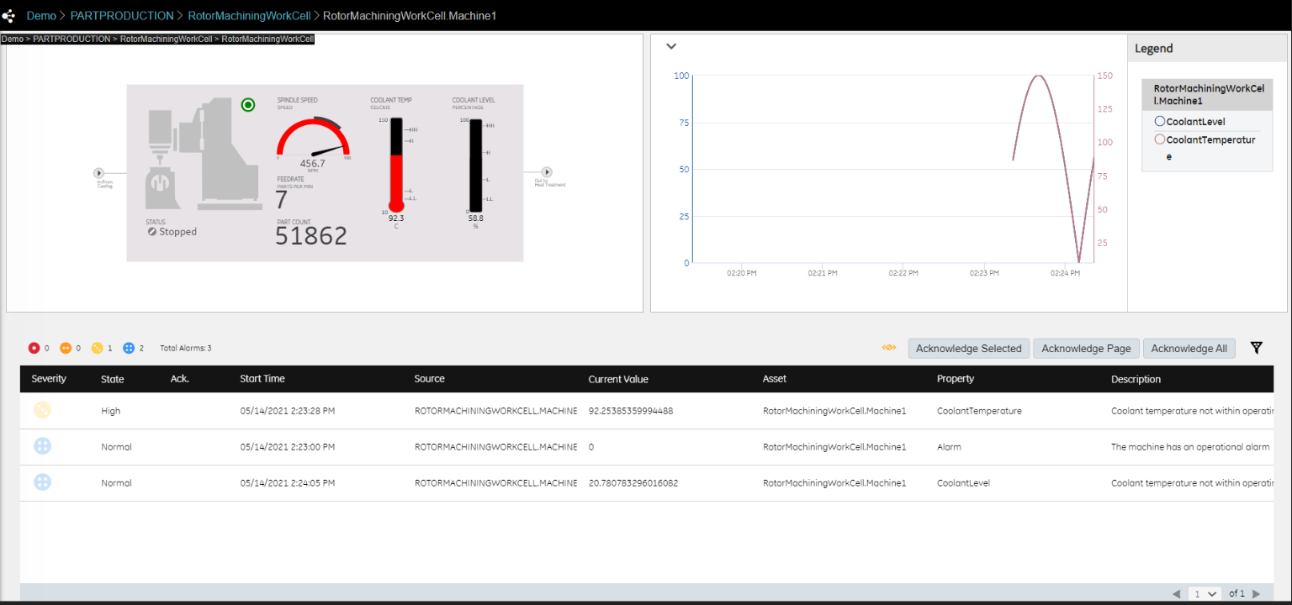
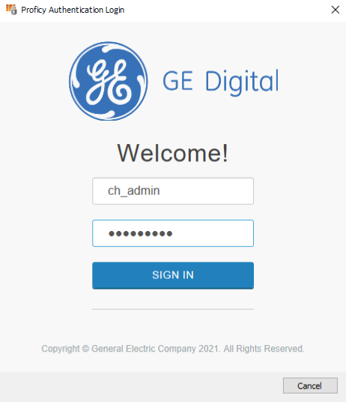
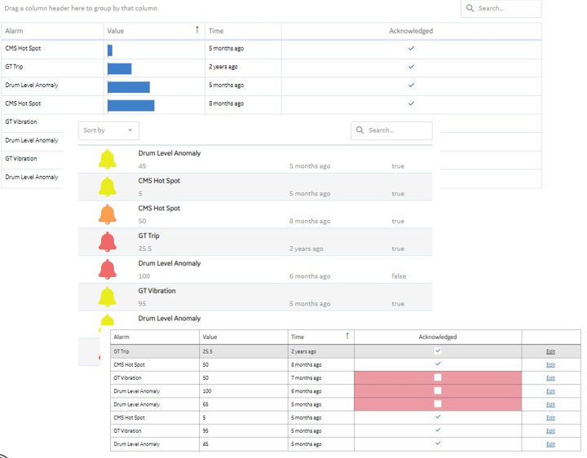
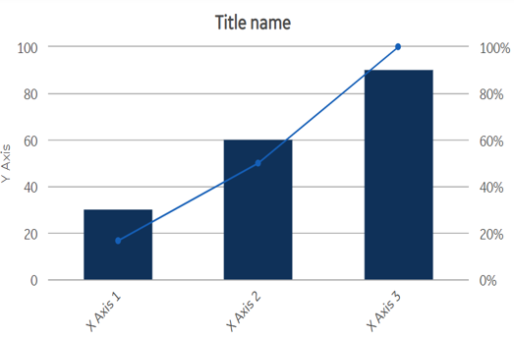
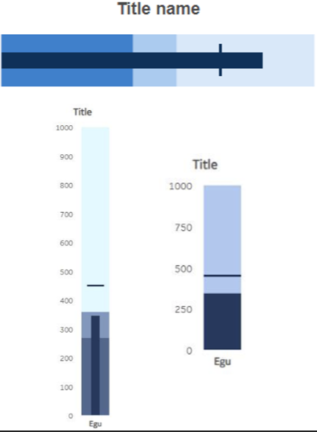
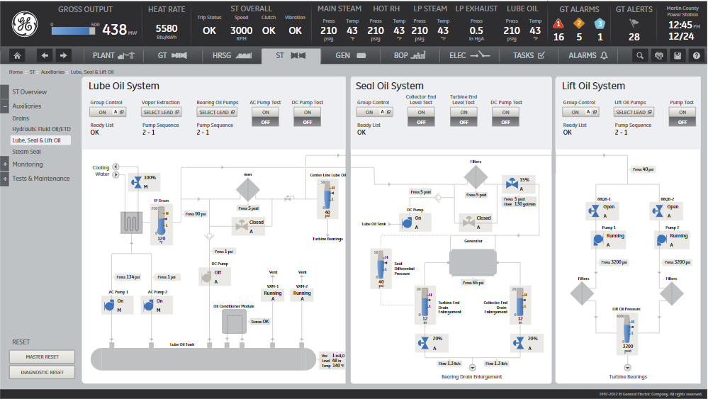
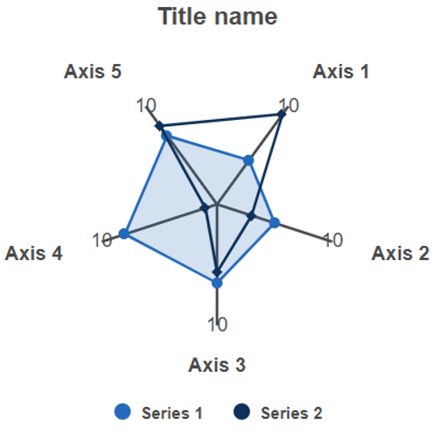
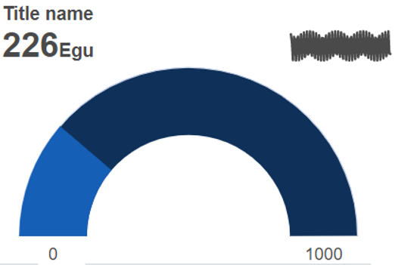
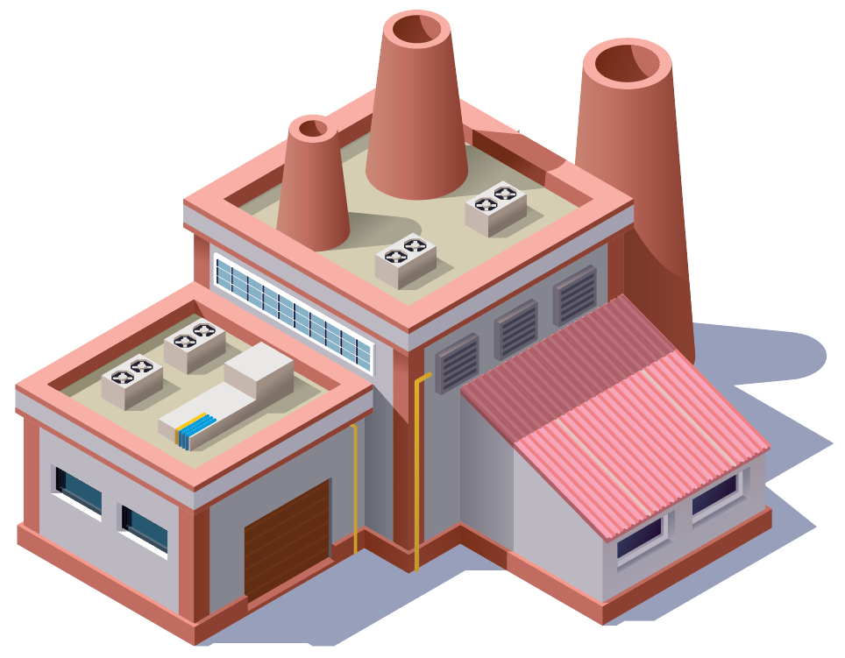
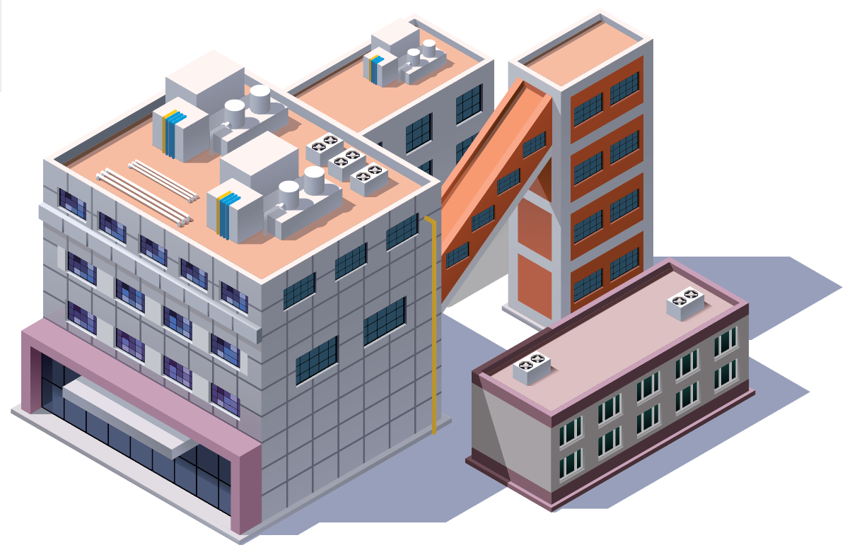
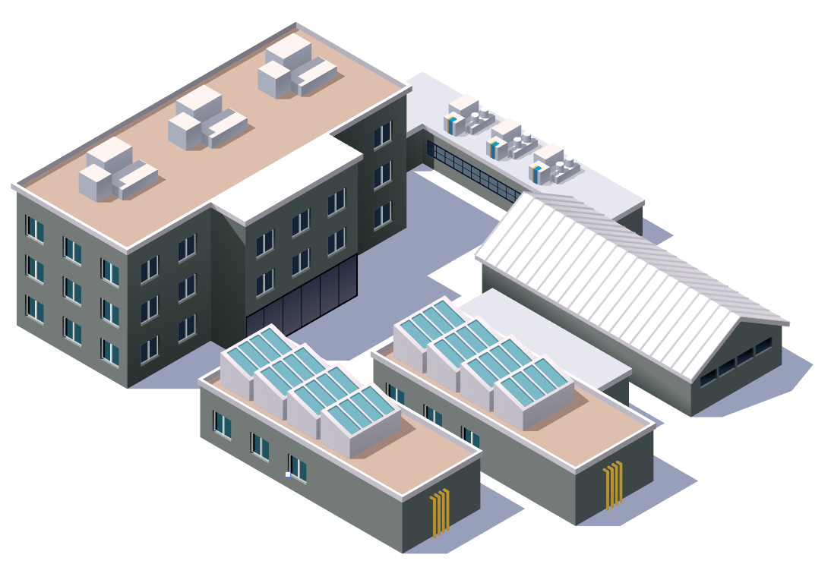
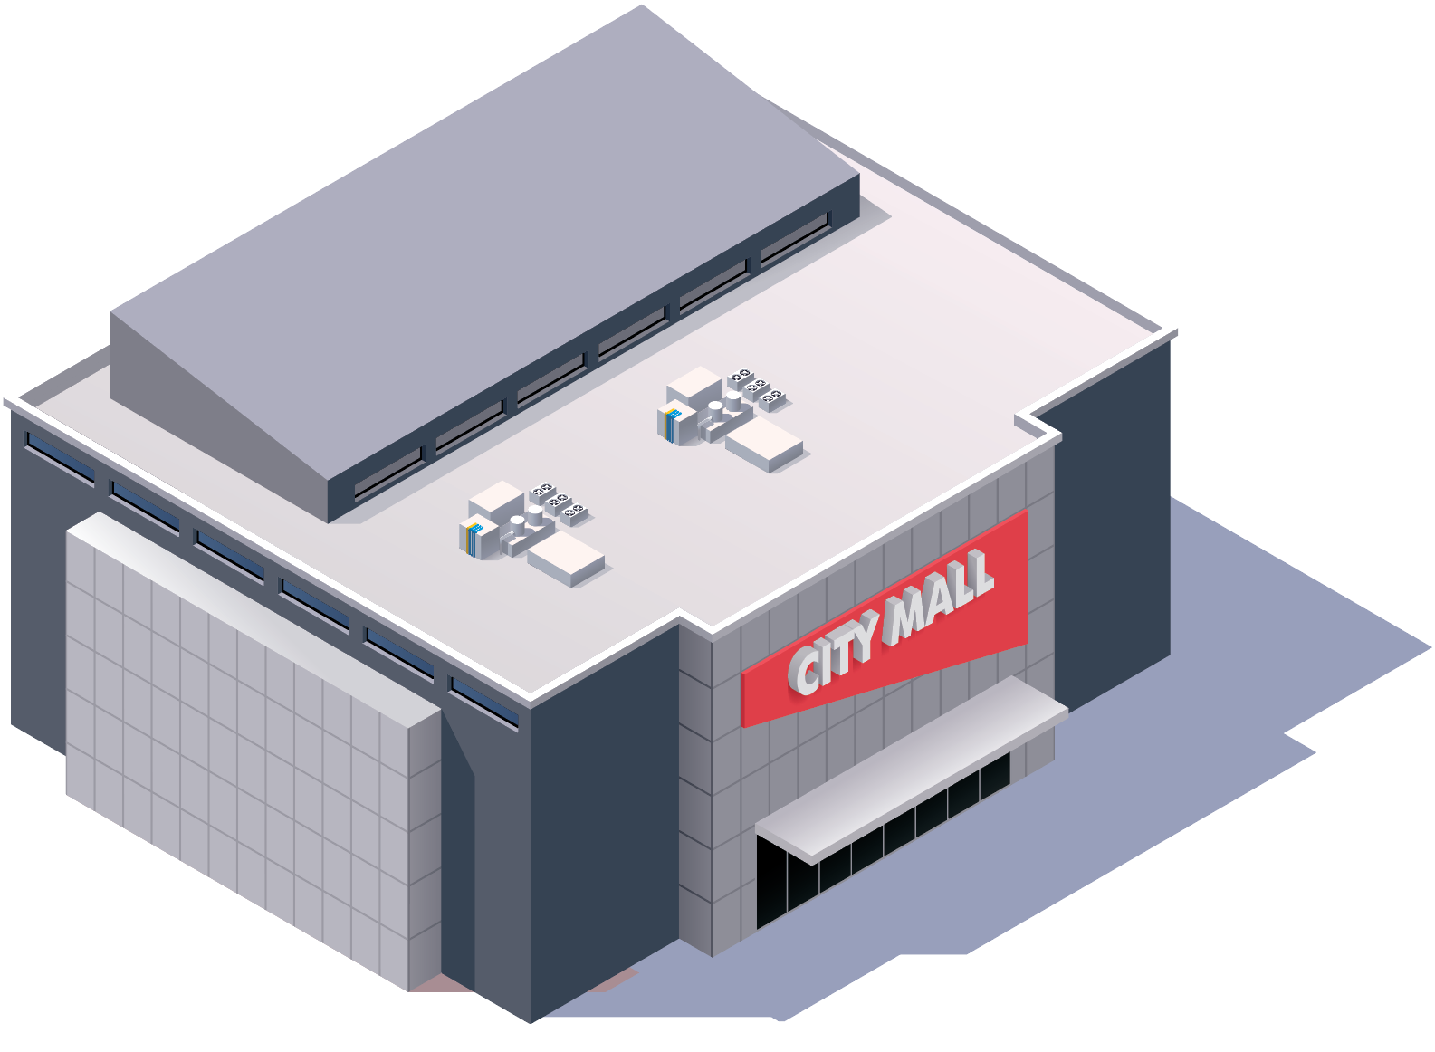
Centralized Management Vision
Visualization
Security
System Health & Diagnostics
Model
Centralized Management Proficy Configuration Hub
SSO
Software License Management
Configuration Change Management
Site 1
Site 2
Site 3
Site 4
Site 5
Software/Patch Updates
Project Configuration/Deployment
Notes:
Centralized Management after years of development remains as just a vision in many customer minds

Slide 14
Connected Worker
Vision
Integrated, simple to deploy configurable, extensible UX platform enabling application development per persona
Integrated with GenAI technology to accelerate development and enable natural language query of OT data
2025
Common, single UX platform across all Proficy applications (HMI/SCADA, Historian, Smart Factory, Sustainability)
Integrated client-side (Python) scripting
Fully containerized, scalable & highly available
GraphQL simplifies visualizing MES data
Notes:
Operations Hub is key being the central visualization platform catering to persona-based application development. Also investing in AI technologies to see how it can help accelerate

Slide 15
Cloud Transformation
Vision
Fully cloud / cloud technology enabled portfolio
On-premises, Hybrid, and Full Cloud
Gen AI & ML enabled
Always on, Always up to date
2025
Proficy Smart Factory, Historian & Operations Hub marketplace solutions
Proficy Smart Factory, Historian and Operations Hub, Csense, and Data Hub SaaS offerings
Accelerating Scheduler SaaS offering
Notes:
Vision / what we are delivering & coming in the next 6 months...
Cloud Transformation does not mean we will only deal with cloud native tech, it means that not only can you run in the cloud, we will also help with cloud enabled tech and tooling to support, on prem, hybrid or cloud, providing flexibility for deployment

Slide 16
Sustainable Insights
Vision
Supports operationalization of Sustainability goals across the enterprise
Aligns to broader ESG initiative and reporting
Integral element of the Proficy portfolio
2025
On-Premises and Cloud deployed solutions
Focused on operationalizing efficient use of natural resources
Built in ML models to baseline operations in the manufacturing / product context and identify opportunities for improvement
Notes:
Difference between what we are doing in sustainability v/s generally, that we can connect energy related data with the data we get from our core products. For e.g. a water customer, if they are running 4 pumps instead of 3 what is the difference in energy, we should even be able to predict the energy efficiency – all of this will be possible due to the common namespace/model

Slide 17
Proficy Products update

Slide 18
iFIX – Summary of Key Technology & Capability Updates
Process Engineer
Developer
Technology updates
TCP/IP based Redundancy
OPC UA Server and Client
HTML5 based HMI –scalable graphics
Model based configuration & runtime
Lab
Remote Operator
Added capabilities
Operator
Maintenance
Alarming
ISA 18.2 Alarm Shelving & Suppression
Enhanced Alarm Distribution Performance
ML based Alarm Intelligence
Centralized Management
Configuration
Project Deployment
Licensing
Advanced Security
Multi-Factor Authentication
Nested Active Directory Support
LDAP Support
Notes:
We opened TCP path for enhanced failover so that users can have SCADA pairs geographically separated . In the past the failover mechanism was using UDP protocol and required the crossover cable, With TCP we get the benefit of enabling the pair be separated - On Prem SCaDA paired with cloud scada
Ifix SCADA is now enabled as OPC UA server. Ifix also has a driver to connect to other OPC UA servers and bring the data to Ifix database tags
HTML5 is Operations Hub screens that can use iFix as datasource
Users can create a Model on top of iFIX SCADA and tie ifix graphics to that model, The browsing of model is added to expression builder of ifix pictures

Slide 19
iFIX 2024
Enhanced visualization
Centralized management
Alarm Scale
Enhanced
alarm Capability
Advisory analytics
Aspect Ratio Based Scaling
Ability to define an aspect ratio for regions of the screen and have visual content scale according to the aspect ratio.
Click Zones
Ability to navigate and perform other actions through user clicks on HMI graphics
Centralized License Management
View and manage all licenses in a system/architecture from Configuration Hub
Deploy licenses to systems as needed to properly address the architecture
Support for term license enforcement
Central Registration Improvements
Streamline processes to Register / Unregister / Migrate / Upgrade in Configuration Hub for efficient Centralized Management
Alarm Generation & Distribution Performance Enhancement
Increased network packet size and packet compression for more alarms in a single packet, speed network throughput
Refactor the alarm distribution for faster communication with clients
Added Diagnostics information to better understand the system.
Up to 80% reduction in alarm generation & distribution time during alarm floods
Workspace start-up performance enhancements for up to 80% improvement
Security Areas Flexibility
Choose of “AND” / “OR” in relating multiple security areas to fine tune functionality without creating new security area
Alarm Counters Evolution
Improved filtering, analysis and event triggering capability, more granularity in alarm counters
See acknowledged & unacknowledged alarms in both unshelved & shelved categories
Alarm Analytics – access to alarm patterns for troubleshooting alarms
PID Control Loop Health Monitoring
Notes:
Security Area configuration: Expand the rules applied to who can write to iFIX Tags. For stricter rules and leverage fewer Security areas follow the AND path. For more liberal ways of controlling iFIX Tag writes follow OR path which exists with past versions of iFIX.
Additional Alarm counters to assist application developers When dealing with Shelved/UnShelved alarms in the iFIX SCADA.

Slide 20
iFIX Performance / Scalability
Alarm Generation & Distribution Performance
Increased Network packet size and Compressed alarms so more alarms in single packet
Refactor the alarm distribution to more clients so its faster
Increased Network throughput has a positive effect in the rest of the system!
Added Diagnostics information to better understand the system.
In testing we are seeing upwards of a 80% Reduction in Alarm Generation & Distribution time during Alarm Floods!
Workspace Startup Time Improvements
Faster Workspace build time when set to start up in “Run Mode”
Also helps with remote applications like Webspace and Terminal Services
In testing WorkSpace Startup Time Improvements, we are seeing upwards of 80% Improvement

Slide 21
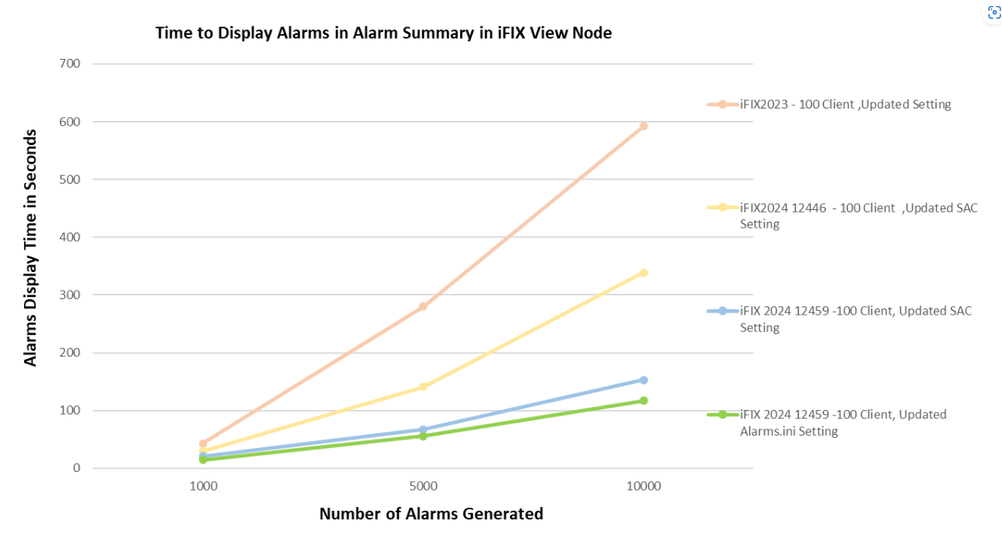
iFIX Performance / Scalability Alarm Generation & Distribution Performance

Slide 22
iFIX Picture Open Performance Update
Aiming at significant improvement over 2022 / 2023
Sub 1 second Picture Open times
Worked with several Channel and Customer use cases / real projects for development efforts and testing
iFIX 5.5 identified as “The Benchmark” for iFIX Picture Open Performance
iFIX Sample System Test Results
Notes:
We focused the developments this year early on in pursuit of faster picture open times.

Slide 23
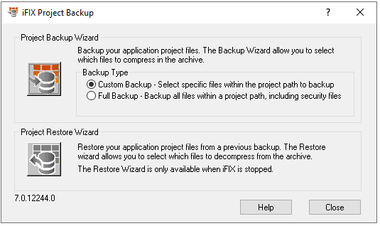
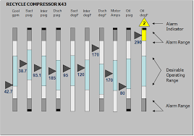
Enhanced Backup & Restore Utility iFIX 2023+
Ability to create a backup (FBK File) from a node on an older iFIX Version (tested back to iFIX 5.5) and restore to an updated node on iFIX 2023+
iFIX 6.0
iFIX 2023+
Proficy 2023 update
Notes:
We have great tools for customer upgrades including the ability to restore a backup from an earlier version directly to a new node

Slide 24
CIMPLICITY – Summary of Key Technology & Capability Updates
Process Engineer
Developer
Technology updates
OPC UA Server and Client
HTML5 based HMI –scalable graphics
MQTT5 Support
Lab
Remote Operator
Added capabilities
Operator
Maintenance
Alarming
Custom Alarm attributes
Filtering based on Alarm attributes
Centralized Management
Configuration
Licensing
Advanced Security
Digital Screen signing

Slide 25
CIMPLICITY 2024
Enhanced VISUALIZATION
Security and Uptime
CENTRAL Management
Enhanced CAPBILITY AND SCALE
Analytics for HMI
Operations Hub HTML5 HMI – Enhanced Trending, new click zones, additional animations for enabling improved visual experience for operators.
Enable remote project start and stop using digitally signed interface
Active update leveraging CIMPLICITY Redundancy. Perform bulk changes on a running project without downtime.
Centralized Licensing – Manage license allocation to Servers and clients. Manage tag allocations to servers
Configuration Hub registration to facilitate shared portfolio integration
Global Class Library enables consistency and maintainability across CIMPLICITY applications leveraging classes/objects
Support for multiple event managers enables higher scalability by allowing multiple event services to run on server.
Improved Alarm viewer performance for large systems
Reduced process start up time
Alarm Analytics – access to alarm patterns for troubleshooting alarms
PID Control Loop
Sensor Health Monitoring

Slide 26
Redundant Configuration Update – Active Update
RCU Sequence
Use Cases
STEP # | Primary | Secondary
 | REDUNDANT CONFIGURATION UPDATE : BEGIN
1 | Primary is stopped
2 |  | Secondary detects primary is down & assumes Active role.
3 | Configuration update is done on primary
4 | Primary is started & detects Secondary is Active and settles as Standby
5 |  | Secondary sends Updates (runtime data) to standby.
6 | Reconcile the data coming from Standby updates. Data folder on primary is manipulated & sent to secondary.
7 |  | Secondary is stopped & configuration update is done on secondary.
8 | Primary detects Secondary is stopped & assumes Active role. Primary now sends out dynamic configuration messages for points that have changed.
9 |  | Secondary is started
 | REDUNDANT CONFIGURATION UPDATE : END
Primary State | Secondary State | RCU Sequence
Stopped | Stopped | Not Allowed
Running | Stopped | Not Allowed
Running | Running | Allowed
Stopped | Running | Allowed
Primary
Secondary
RCU
Client 1
Client 2
Client 3
© 2024 GE Vernova and/or its affiliates. All rights reserved.

Slide 27
MES – Summary of Key Technology & Capability Updates
Process Engineer
Developer
Technology updates
Kubernetes support for SaaS deployments
Kafka to MQTT support
GraphQL data acess support
Lab
Remote Operator
Added capabilities
Operator
Maintenance
Web Administration
New Autolog capabilities
Manual Batch
Engineering Change
Document Management
Predictive Downtime

Slide 28
Proficy Plant Applications 2025
Modernize Backend & Improve Scalability
Rich Web-based Administration & improvements to the UI
Faster time to solution
More OOTB manual batch capabilities
AI/ML Predictive Analytics
Kubernetes support on SaaS and on prem for both backend and web client frontend
Enterprise level multi-Site capability including an ISA95 plant model, independent materials, BOMs and routes by site on the same server
Modernization of the backend with 64-bit and microservices for ultimate scaling ability as well as built in high availability
Support for Python, AWS Lambda and Azure Step Functions in core models
Replace over 50% of the capability in the thick administrator with a web-based Configuration Hub plugin
Backward compatible 64-bit Excel Add-in that works with Office 365 and Office Online – COMPLETE and Available
New Autolog supporting additional events and embedded into discrete operator screens
Integrated Elastic Search for faster troubleshooting
More Operations Hub widgets to provide a standardized yet customized user experience.
Downtime widget – sizable and driven from other Operations Hub widgets and customer input
Activities operator “to do” list widget
Kafka to MQTT broker
GraphQL read data access & Operations Hub connector
Engineering Change Process
Streamline operations with batching (e.g. furnace) & grouping for multiple mutual exclusions
Track tools and insure calibration
Operator qualification enforcement
NCM hard vs. soft holds & standard rework ops
Repurpose scrap with downgrade material capability
Document Management
SaaS only
Predictive Downtime for specific industries; a digital twin of equipment built with the customer’s own equipment data can give early warnings before a unit stops avoiding costly unplanned downtime
True Root Cause Downtime; use process and context data to get insight and understand the real reasons for stops, allowing to improve maintenance, value flow, etc.
Notes:
Modernize Backend & Improve Scalability
Kubernetes support for backend and web client front end for both on-prem and Cloud offering
Enterprise level multi-Site capability including an ISA95 plant model, independent materials, BOMs and routes by site on the same server
Modernization of the backend with 64-bit and microservices for ultimate scaling ability as well as built in high availability
Rich Web-based Administration & improvements to the UI
Replace over 50% of the capability in the thick administrator with a web-based Configuration Hub plugin
Backward compatible 64-bit Excel Add-in that works with Office 365 and Office Online
New Autolog supporting additional events and embedded into discrete operator screens
Faster time to solution
Expose regulatory capabilities in the web client
Integrated Elastic Search for faster troubleshooting
More Operations Hub widgets to provide a standardized yet customized user experience.
Downtime widget – sizable and driven from other Operations Hub widgets and customer input
Activities operator “to do” list widget
More OOTB Discrete capabilities
Engineering Change Order app includes approvals
Batching of operations (e.g. furnace)
Groups of operations
Tool traceability during order execution
Qualifications to limit what an operator can work on including operations and quality
Extend Document Management
NCM extensions
Downgrade material capability
AI/ML Predictive Analytics
Predictive Downtime
True Root Cause Downtime
Balance speed and quality for max production

Slide 29
Proficy Smart Factory 2025 SaaS
Technology
Visualization
Timeseries
MES
High Availability
Autoscaling
Zero Downtime Upgrade
MQTT Publisher
Kafka Consumer/Producer
Data Hub
Scripting:
Client Side
Python
User and other context available
Accepts all Operations Hub data sources
Enhanced Data Binding
Cloud A&E
ETL tool enhancement
Automatic Archive file repair
Simplify security groups
New prebuilt reports
Tag Monitoring Analytics: bad tags
GraphQL Connector
Additional MES Widgets
Predictive Downtime
True Root Cause detection
Operator Qualification Enforcement
Document Management - Gen AI summarization
Engineering change process
Tool Tracking
Notes:
* Zero Downtime Upgrade – Feasibility investigation. To be realized for the upgrade following 2024.
** May trail 2024 release/not tied to date directly
Also includes selection of critical customer request
Plant Apps 2025 will include
the remaining core elements needed for complex discrete assembly: Doc Mgt, Operator Qualifications, Tool Tracking, BOM enhancements like substitute materials and splitting consumptions, disassembly
containerized 64-bit backend and multi-site capabilities
Plant Apps 2025.1 will include additional discrete and process capabilities plus better integration elements like logic "exits" and x% of Autolog parity

Slide 30
Embedded ML Capability

Slide 31
Included ML Model – Alarm Patterns
Notes:
Defines a new alarm pattern as the sequence of unique alarms (no repeating alarm will be added to the sequence more than once) that follow any 10-minute (or longer) period without any new alarms activating.

Slide 32
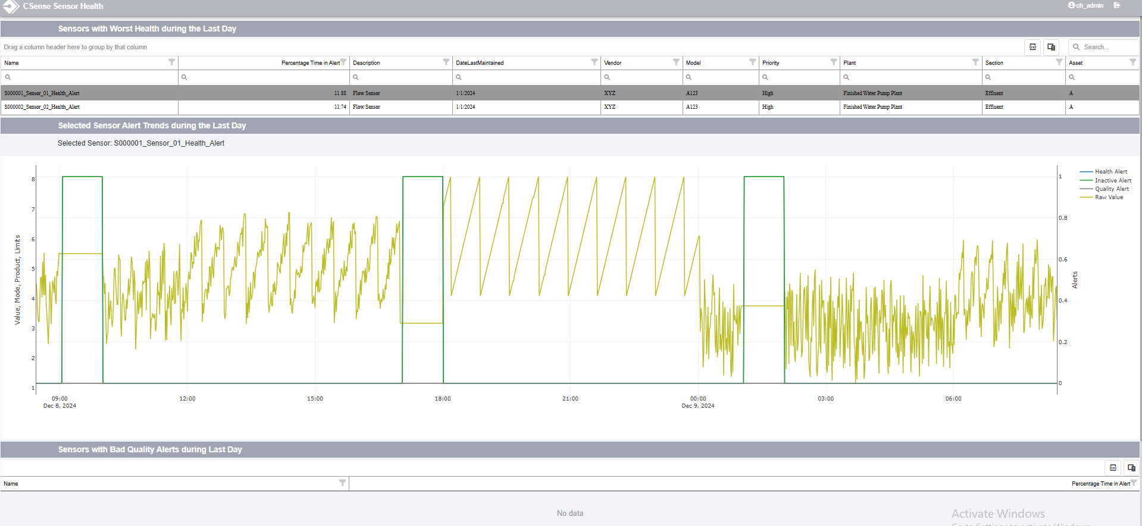
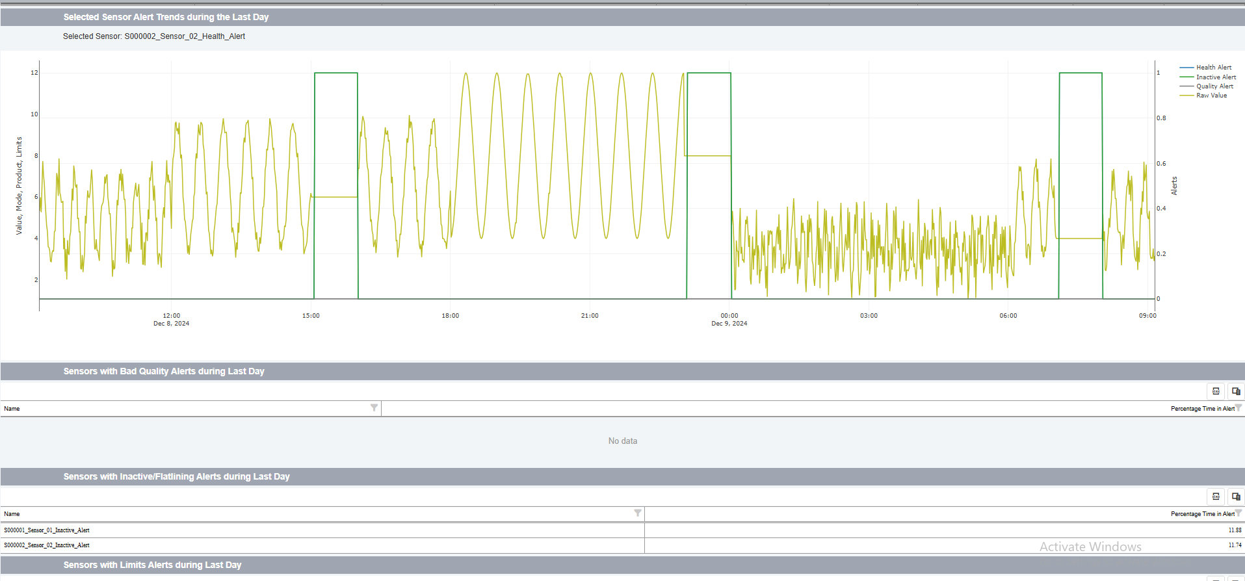
Included ML Model – Sensor Health (Quality of Sensor Data)
Notes:
designed to monitor the health of analog sensors (i.e., sensors that measure continuously changing entities, and when healthy, are never expected to produce BAD QUALITY data or have precisely the same value for any consecutive readings) to detect unhealthy sensors that are producing BAD QUALITY data, are inactive (flatlining), or are producing reading that are outside normal expected operating limits.

Slide 33
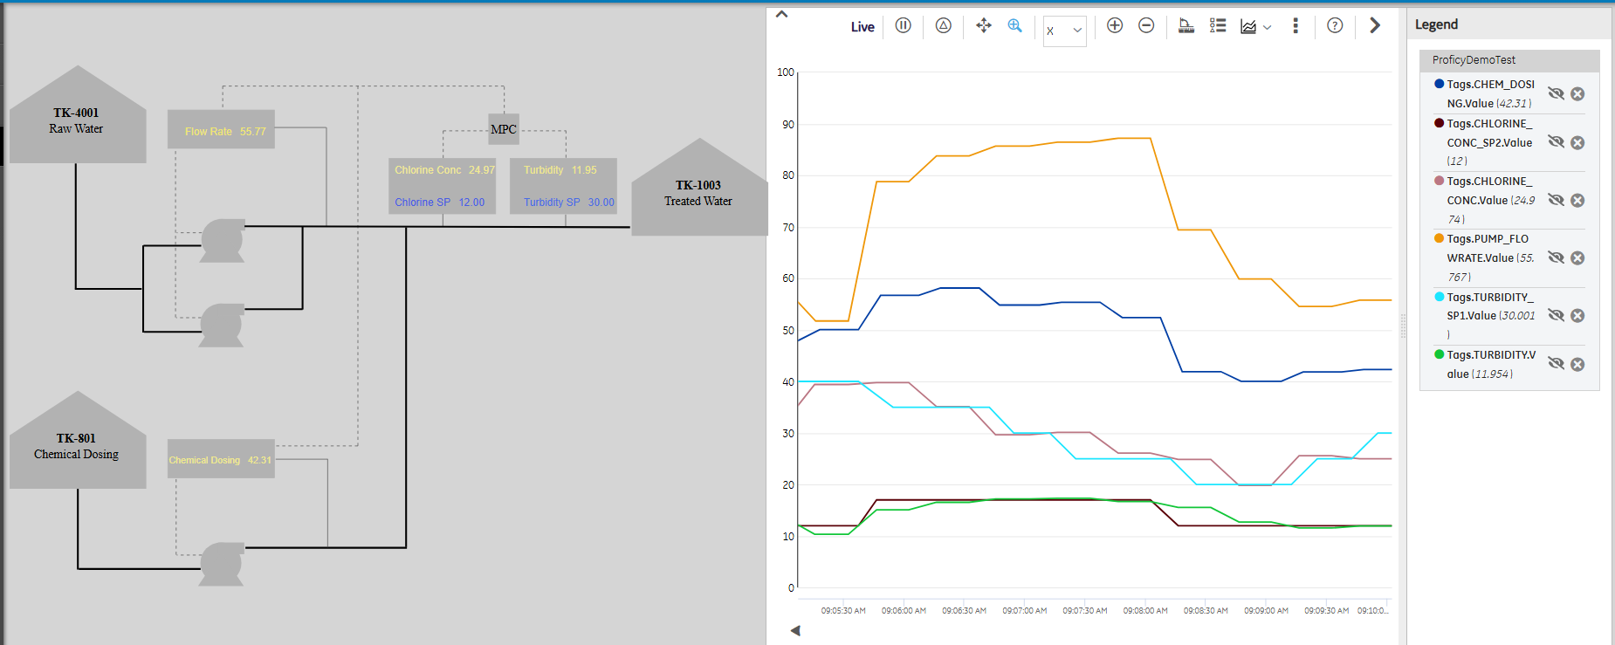
Included ML Model – Model Predictive Control
Chemical dosing in Water Treatment Plant
Notes:
Model Predictive Control (MPC) is the most popular multi-variate multi-input multi-output (MIMO) advanced control technique in industry. It is used to stabilize and optimize the dynamic control of multi-variate processes where simple SISO (single input single output) PID control loops are not suitable due to reasons like strong input/output interactions, multiple input and outputs to be controlled and long process delays or dead-time. Proficy CSense has out of the box MPC capabilities.
Example Problem:
•Inputs: Adjust chemical dosing and flow rates.
•Outputs: Control turbidity and chlorine concentration.
•Objective: Minimize dosing cost while keeping turbidity below a certain limit and chlorine between a certain range
This 2x2 example forms the basis of larger, more complex MPC systems by adding more inputs and outputs based on plant needs.

Slide 34
Value of data historian and Data Hub

Slide 35
Transformations Happening in Data Management
Hybrid-cloud approach is becoming a necessity, esp. for regulated industry
Centralized data lakes power scalable, flexible, efficient unified data systems
Unlock insights for analysis & advanced decisions with a global data model
Increase security by only exposing information at the highest level
Low-code/no-code solutions to democratize data & empower workers
Notes:
https://adastra.digital/blog/unraveling-the-future-top-data-management-trends/#:~:text=The%20multi%2Dcloud%20approach%20is,workloads%20across%20different%20cloud%20platforms.
Generally, a lot of change in data mgmt., these are the things we are focusing on…Operations hub is our low code/no code solution for connected workers. We have increased focus on security with pen test and moving to the cloud also provides layers of security. Centralization of data comes in with Historian and the data hub

Slide 36
Data is the biggest Challenge for Transformation
Only 3%
Of Data is Tagged and Analyzed
International Data Corporation
75%
Surveyed manufacturing executives consider advanced analytics to be critical for success
Assembly Magazine
9%
Unstructured, Needs Interpretation
40-80%
Unused Data, (depends on Industry)
Wharton School of the University of Pennsylvania

Slide 37
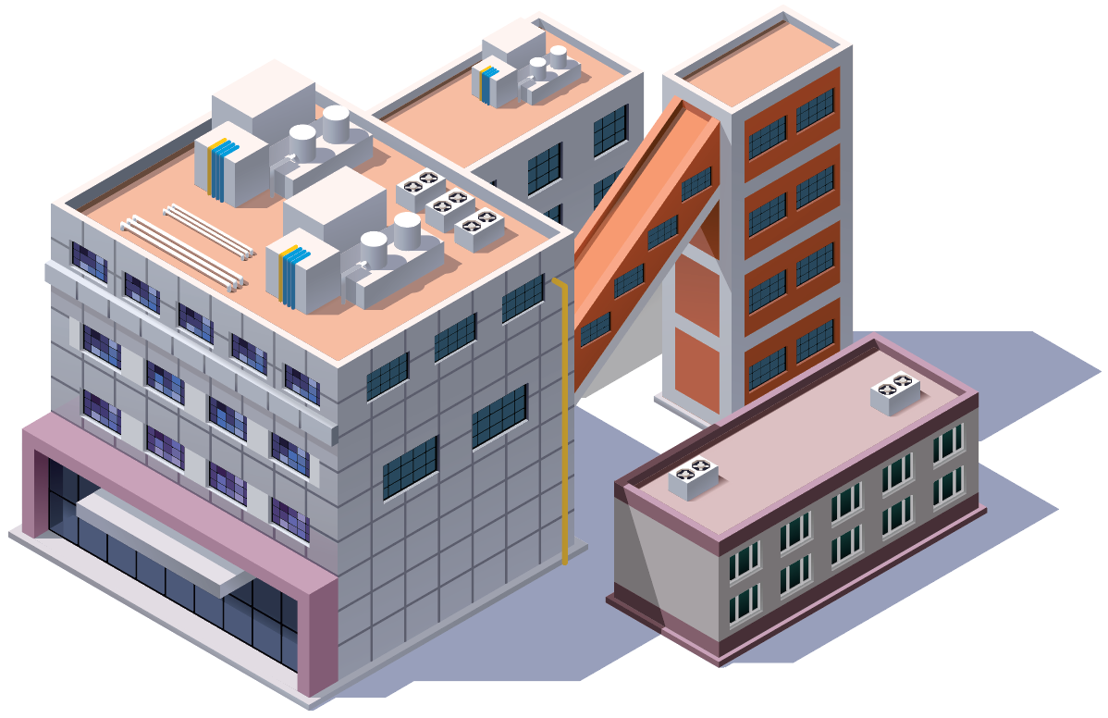
Siloed Context and Lack of Ownership Who owns Data Normalization?
Enterprise planner
Improved on time delivery through better visibility into plant performance and production execution correlations plant manager.
ENTERPRISE
Product/Compliance/Quality office
Faster time to market via a connected product data network enabling faster NPI and product improvement decisions.
Lack of Production Context
Translation of Business vs Production, mostly based on situation
Plant manager
Improved operational agility and production execution resulting from enhanced production visibility across assets and sites gained from production variances.
Engineer/IT
Ease of integration configuration and management of product data across the plant.
Need to know Business context
Plant operator
Changeover and production improvements driven by improved consistency of batch performance information and insights.
Plant QA
Increased spec compliance as a result of better traceability into production variances.
PLANT
Notes:
Data Hub helps solve this problem, data is democratized and can be used by all to solve complex business problems

Slide 38
Digitization seems to be central to these Outcomes
Data governance
Cross-operations, flexible workflows and persona-based controls for tag unification, consistent, and contextual data management across sites.
Security measures
Highly-visible operations information and remote access may conflict with security measures against increasingly sophisticated attackers.
Infrastructure upgrades
Point-based solutions may hinder operations speed, agility, and production quality – the pace of change has accelerated for innovation.
Change management / employee training
Enterprise-wide communications networks, task management, and performance tracking are key to continuous improvement and competitiveness.
Notes:
Collaboration between IT and OT teams is crucial, as is a commitment to ongoing monitoring and adjustment of the digital transformation process.

Slide 39
Problems customers are trying to solve
Reducing Operational Costs
“Reduce Infrastructure Costs and Expand OT Data Availability”
GE Aviation
Rapid Expansion with Compliance
Increased safety and continuity of Service
“Managing project timelines of rapid expansion while safeguarding a level of standardization for business efficiency”
Novo Nordisk
“Increase the ease of security compliance and customer responsiveness with system reliability”
Utilities & Infrastructure
Faster time to Market
Increased Operational efficiency
“Adapt rapidly and flexibly to ever – changing market demand for new vehicles and technology”
General Motors
“Enable Real time analytics for multiple data sources across multiple plants”
First Quality
Notes:
Across the different industries, customers are looking to move fast, improve quality and look for any increase in efficiency while reducing operating costs. Companies like GM as they transition to EV are looking to how they can deliver faster. NovoNordisk is looking for a standardized and centralized solution that allows them to expand faster. Customers in general are looking for easy and fast ways to access data across their worldwide footprints, to connect plants and get a holistic view of their operations.

Slide 40
Historian 2025
Introducing

Slide 41
Proficy Historian Hybrid Data Architecture
Heterogeneous OT data at scale
A complete OT to data lake solution
Single or multi-site Industrial
Large volumes of OT data from variety of sources (SCADA, DCS, Historians, IoT)
Get the right data into the data lake at high scale
Central/Enterprise Proficy Historian
Dashboards
Proficy Historian for Cloud
Big Data Analytics
Digital Thread
And more …
Cloud-enabled capabilities
Zero Downtime Upgrades
Availability / Always On
Multi site MES capability
SaaS
Scalability – as much as you need
Site Proficy Historian
SITE #1
MES Data
External Data Source
3rd Party Proficy Historians
Other Site Proficy Historians
SCADA & Control Systems
SCADA & Control Systems
Aggregation across the Enterprise
Several to many plants
Different data sources per plant
Enterprise scale data governance
Ability to view aggregate data across the enterprise to do cross business analytics and optimization
Cloud deployed Historian for a plant
Operational historian needed
Data needs to get to the cloud eventually
Ability to migrate legacy data
Reduced IT costs & TCO
Notes:
City of Roseville water department- converting 3 on prem historians into one cloud based
We do not have mandate to go to the cloud, we have an architecture that meet our customers with where they want/need to be. We have cloud expertise with SaaS, manage the customer accounts and security etc. and manage in the cloud.
Historian has been architected for scalability, so before if you had several collectors they would collect into an archive, but now with this scalability so if they are a 100 collectors, each can get their own archive, you can scale from 1g to 10terabytes without any degradation so there is no bottleneck- we have large utility customers leveraging this
Hybrid: Can collect from on prem to cloud and avail of the SaaS advantages including scalability and always be up to date
We tie into the Smart Factory system and get multisite, scalability, etc
You could have in prem historians that aggregate into a cloud Hisotrian which then will have redundancy and the other cloud capabilities that come with it like high availability, load balancing, etc

Slide 42
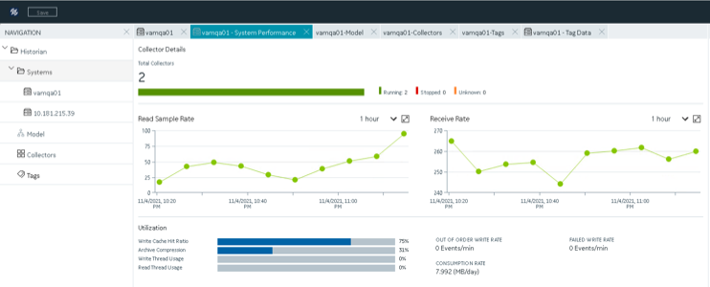
High Scale Historian
Best in class management of enterprise scale systems (up to 100MM tags) and widely distributed applications with 1000’s of data sources.
Historian is 33x more efficient on disk than competition
Improved Integration: Web based Administrator (Configuration Hub), Proficy Installer, Proficy Authentication
Significant improvement in Collector throughput (Multithreaded - 50% increase to iFIX collector)
New Python based Calculation Collector
Asset Model Service enables creation of model context associated with Historian data
Notes:
Key value of our iFIX is our Proficy Historian, allows for greater scale than relational databases like you see in the competitive landscape. It significantly reduces the hardware footprint required and the associated management
Improved Integration – Feel like a single product

Slide 43
Proficy Historian for Cloud Unique, true operational historian, architected for the cloud, deployed in the customer’s VPC
Cloud native historian providing same APIs as on-prem. version, zero integration effort
Simple to predict consumption pricing & fixed fee term license pricing
100’s of protocols, encrypted data to the cloud, data governance
Deployed and managed through Kubernetes, autoscaling, zero downtime upgrades
Multi-pod and multi-geographic zone data replication
Scheduled export to Parquet, simple data lake and analytic integration
Legacy Data Migration from on-prem to Cloud
Proficy Historian
OPC-DA, HDA, UA, MQTT ODBC Proficy Historian OSI-PI 100’s of OT protocols
Proficy Historian
OSI PI
Smart Sensors
HMI/SCADA
DCS
ODBC
MES
SCADA
Plant Systems

Slide 44
Proficy Historian 2025 Enterprise Data and Applications Model
User enhancements
Installer, collector, and tool enhancements to lower functional overhead for Historian
Enterprise Model Support
Add context to data in the model by bringing together data from different sources into a single element
Security enhancements
Encryption and Password security enhancements to increase cybersecurity.
BENEFITS
Enhanced encryption and security features to increase our security posture
DataHub Support
Kafka, MQTT Publisher, installer enhancements
UX enhancements
SaaS Historian
Cloud Scalability
Notes:
With our 2025 release we will have the ultimate enterprise scale Historian. A customer will be able to have their data stored in the way they need regardless of their size and will have access to analytics to drive their business process faster. Our collectors are world class but will now be faster, MQTT data can be published from Historian to any source, we're leveraging AWS to build SaaS and Ultra Scalability.

Slide 45
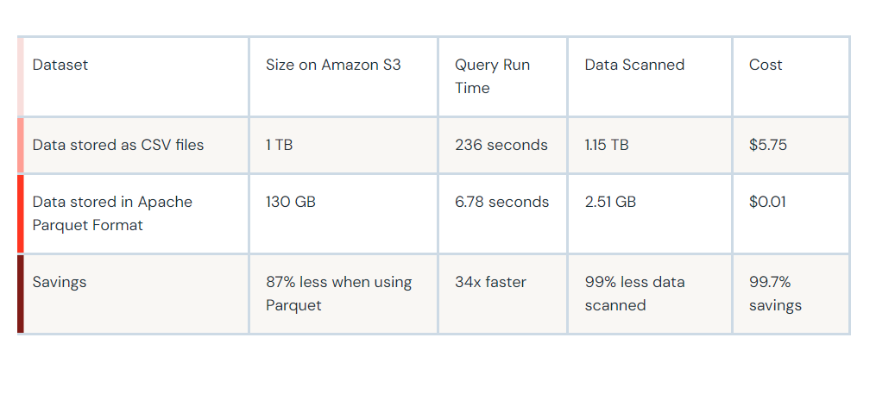
Data Storage Cost Optimization-Parquet Files

Slide 46
Proficy® Data Hub
Introducing

Slide 47
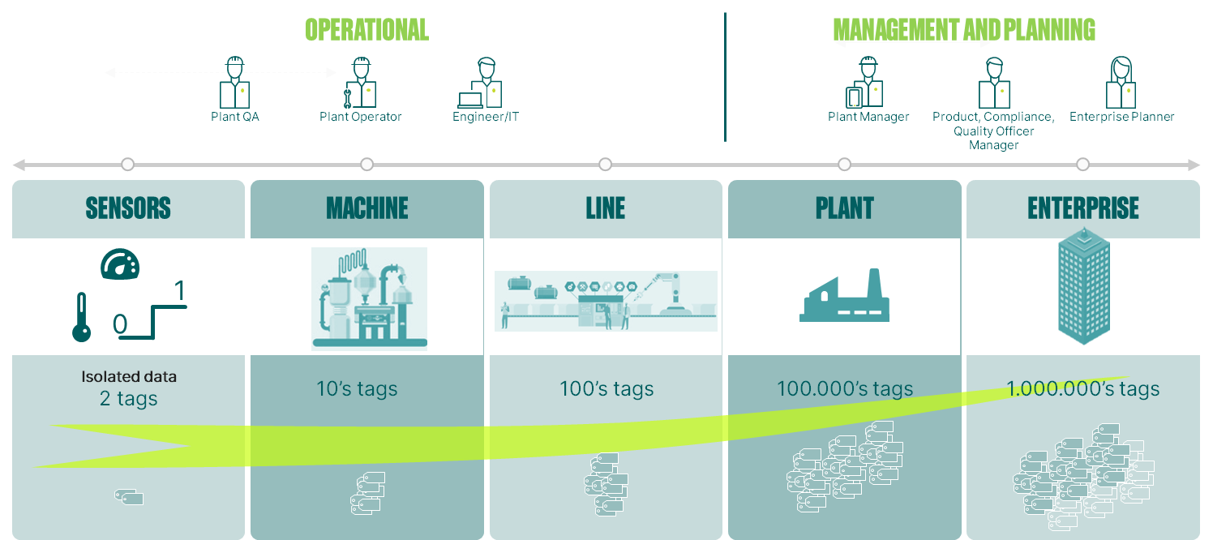
The Data problem of the Industry
Data Scaling issue
Scale of Data derived from Manufacturing is increasing
Unstructured large volumes of data configuration takes months to commission and maintain plant applications
Limited cross-reference
Limited cross-reference between enterprise planning and operational data leads to unnecessary maintenance costs
Timed maintenance on machines/lines without considering potential extension to operational hours cause unwanted downtimes and increased maintenance costs
Missing context to data
Enterprise planners and management lose context of data having to deal with multiple models across plant areas
Only 5% of manufacturers have at least one factory at full smart status and only 30% have smart factory initiatives underway
70% of companies investing in big data analytics artificial intelligence or 3D printing failed to move beyond the pilot phase of development

Slide 48
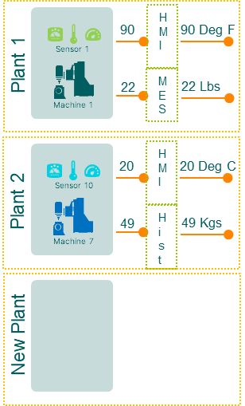
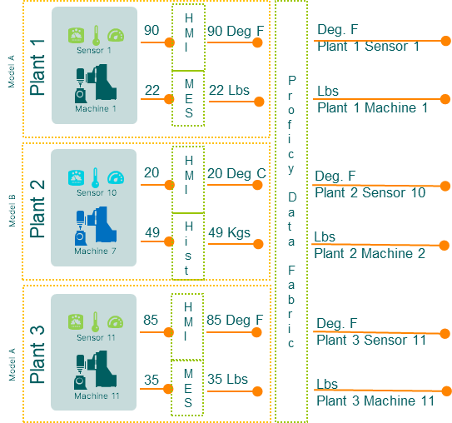
Proficy Data Hub: unlock production data trapped on the factory floor & accelerate deployment
Current State
Future State
Model A
Model A
Data trapped within systems
No asset context to data
New plant configuration can take 18 months
Data available in context for cross enterprise analytics – understandable by anyone
New plant configuration in weeks
Model B
Model B
Model A
Integrated Model & Data Fabric provides contextual naming to simplify accessibility to data & reduces deployment time by up to 80%

Slide 49
Proficy powered by Data Hub
Data Model
Create hierarchical relationships between object types in the directory. Deploy to Proficy applications
3rd Party
Complementary Solutions
Operations Data & Applications Model – Enterprise scale
UNIFIED NAMESPACE
Adds context to Objects in the Model by consolidating data from heterogeneous sources into a single element & timestamp.
Plug & Play customer & partner solutions
BMS
QMS
APS
IMS
WMS
Plug & Play Analytics & Optimization
Analytics
Directory Service
Publish configuration, objects, variables and classes to a central directory that all products can consume.
Proficy
Applications
AI/ML-enabled, Composable, Scalable
MES
Quality | Traceability/Gen. | Efficiency | Process Analysis
Historian
Centralized Configuration, Management & Deployment
HMI/SCADA
Data Fabric
Provides access to data across all products. Minimize/eliminate replicated data access from multiple app. relying on the same data.
Configuration acceleration, Data Integration, Contextualization & Distribution
Data hub
Enterprise model | Unified namespace | Message bus
Unified & Extensible UI/UX
Containerized & Zero Trust Security
Infrastructure
Cloud, On-Prem, Edge
Hybrid Cloud Infrastructure
Notes:
Add the capabilities from #7

Slide 50
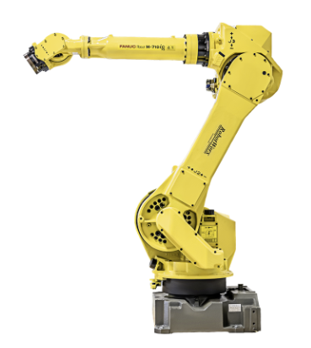
Data Fabric Empowers a Complete Digital Thread
Visualization
Shop Floor(OT)
Data Fabric + Data Ops
Centralized Data Flow
ERP
Time Series
QMS
SCADA
CMMS
accelerates development and enables OT/IT data integration

Slide 51
Proficy Data Hub- Value
Single Configuration
Can be shared across applications to reduce development time
Leverage existing models and data connections
A single source for information, data, alarms across IT & OT.
Reduce traffic from multiple to access both IT & OT data.
Operations Data & Applications Model – Enterprise scale
Import & maintain existing models.
Enhance and augment existing models to enhance data on an object type
A holistic overview of all IT & OT systems across the enterprise
… for comparative views, centerlining/ benchmarking
A common reference for an asset regardless of the application
consistency of visualization, execution logic, analytics, alarms, and more.
Start from an enterprise model & deploy configuration to appropriate systems.
Reduce configuration and deployment time.
Align advanced capabilities
… such as Analytics to the model (lines, equipment, etc.) to enable deployment at scale
51

Slide 52
Single OT visualization design and runtime

Slide 53
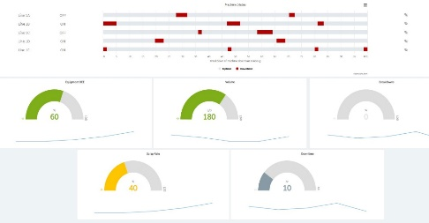
Single experience of processing and interacting with Operations Accessing the information I need when I need it
Common context driven by Model
Single designer for all Operational applications
Total Operations view
Persona based interaction and access
Sustainability Metrics?
Quality data?
100.0
90.0
80.0
70.0
60.0
50.0
40.0
30.0
20.0
10.0
Line efficiency?
Machine Health?

Slide 54
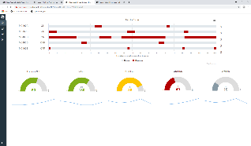
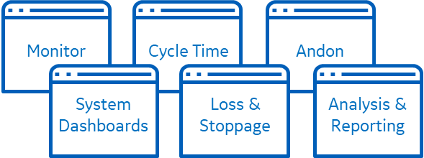
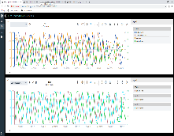
Proficy Operations Hub
A centralized environment to rapidly build industrial applications & design operations interfaces enabling plant operations, analysis, and decision making for plant personnel across the enterprise
Industrial Applications –
Out of the box or build your own!
Accessibility to information - access your data any time, anywhere
Enable creation of high-performance displays
Centrally manage visualization layer across your enterprise
Get additional value out of existing investment in GE Proficy products
Proficy Operations Hub built leveraging domain expertise from Proficy products
Web Apps
Monitor & Control
Dashboards & KPIs
Analysis
Reporting
Digital Andon
Proficy Operations Hub
Designer (Development Environment)
OPC UA
MQTT
REST
SQL
Industrial Automation
Manufacturing Operations Management
iFIX/CIMPLICITY
Proficy Plant Applications
Proficy MDC
Proficy Workflow
Proficy Batch Execution
Proficy Tracker
Proficy Historian
SQL DBs
CMMS, ERP Systems
Other Systems

Slide 55
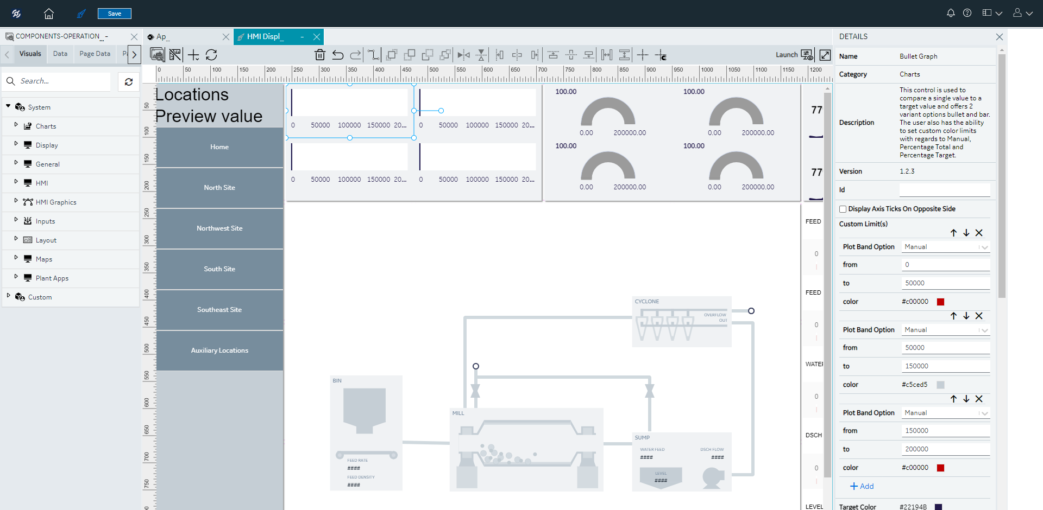
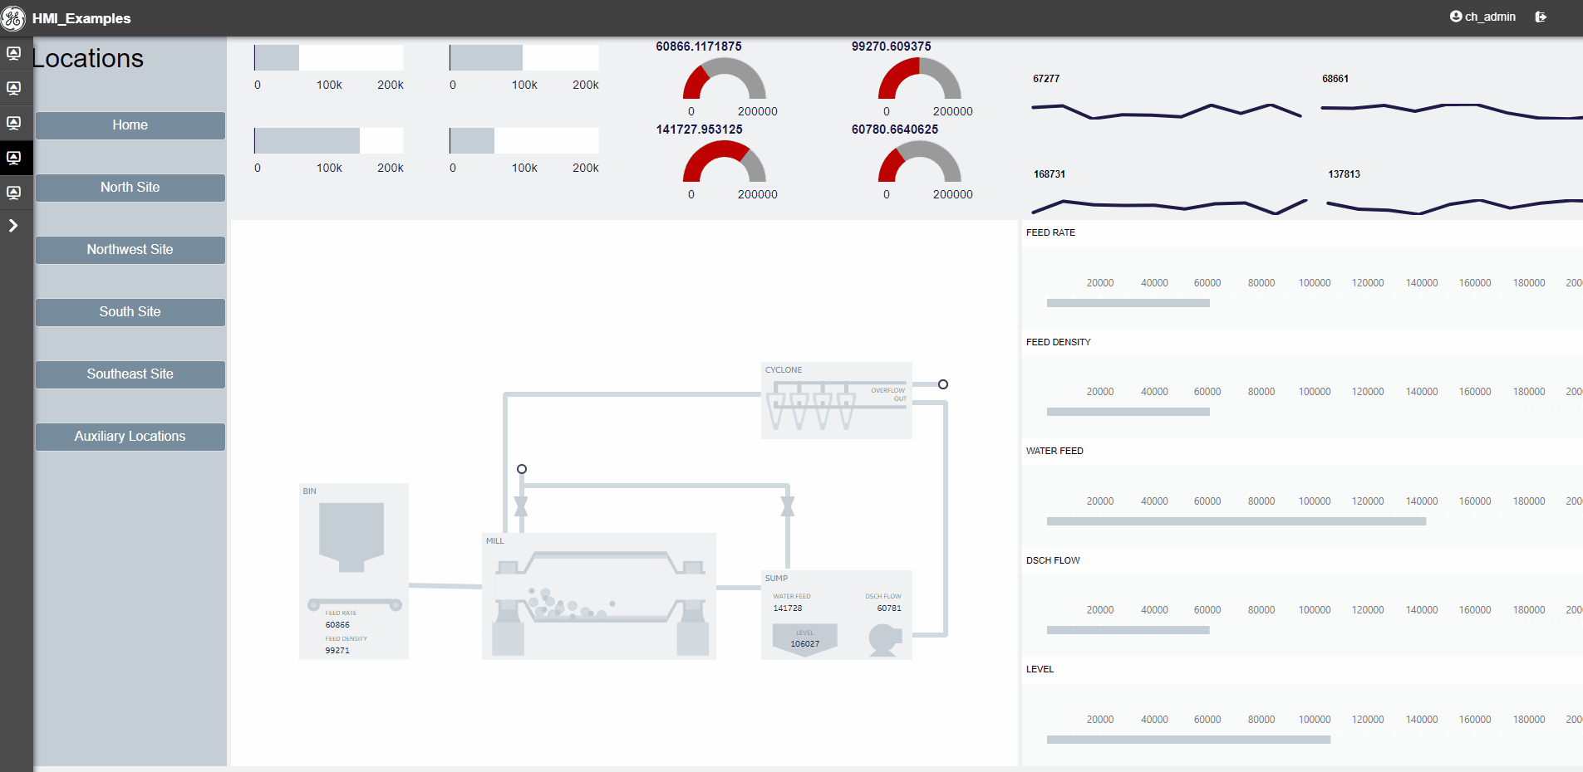
Proficy Operations Hub Designer
Data Connectivity
Data Sources & Queries
Modeling
Visualization
Out of the box widgets
Custom widgets
Screen Building
Drag and Drop Screen Design
Powerful Layout Options
Page Tools
Actions and Conditions
Formulas
Notes:
1:00-1:45
1:45

Slide 56
HMI Creation in Proficy Operations Hub Designer

Slide 57
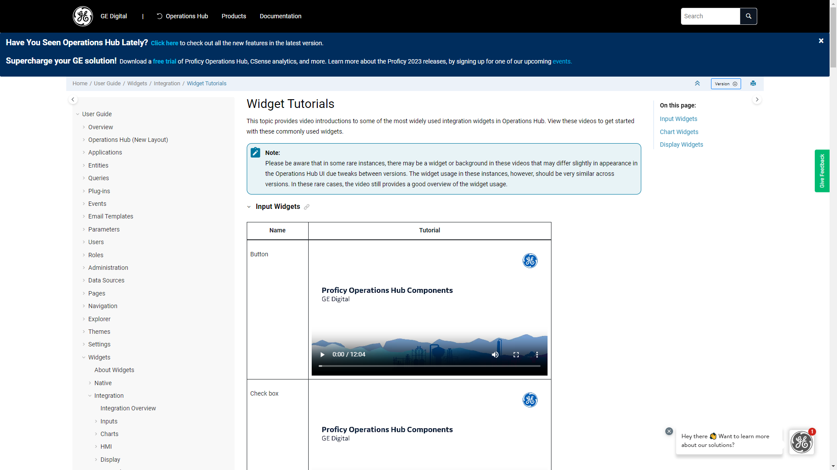
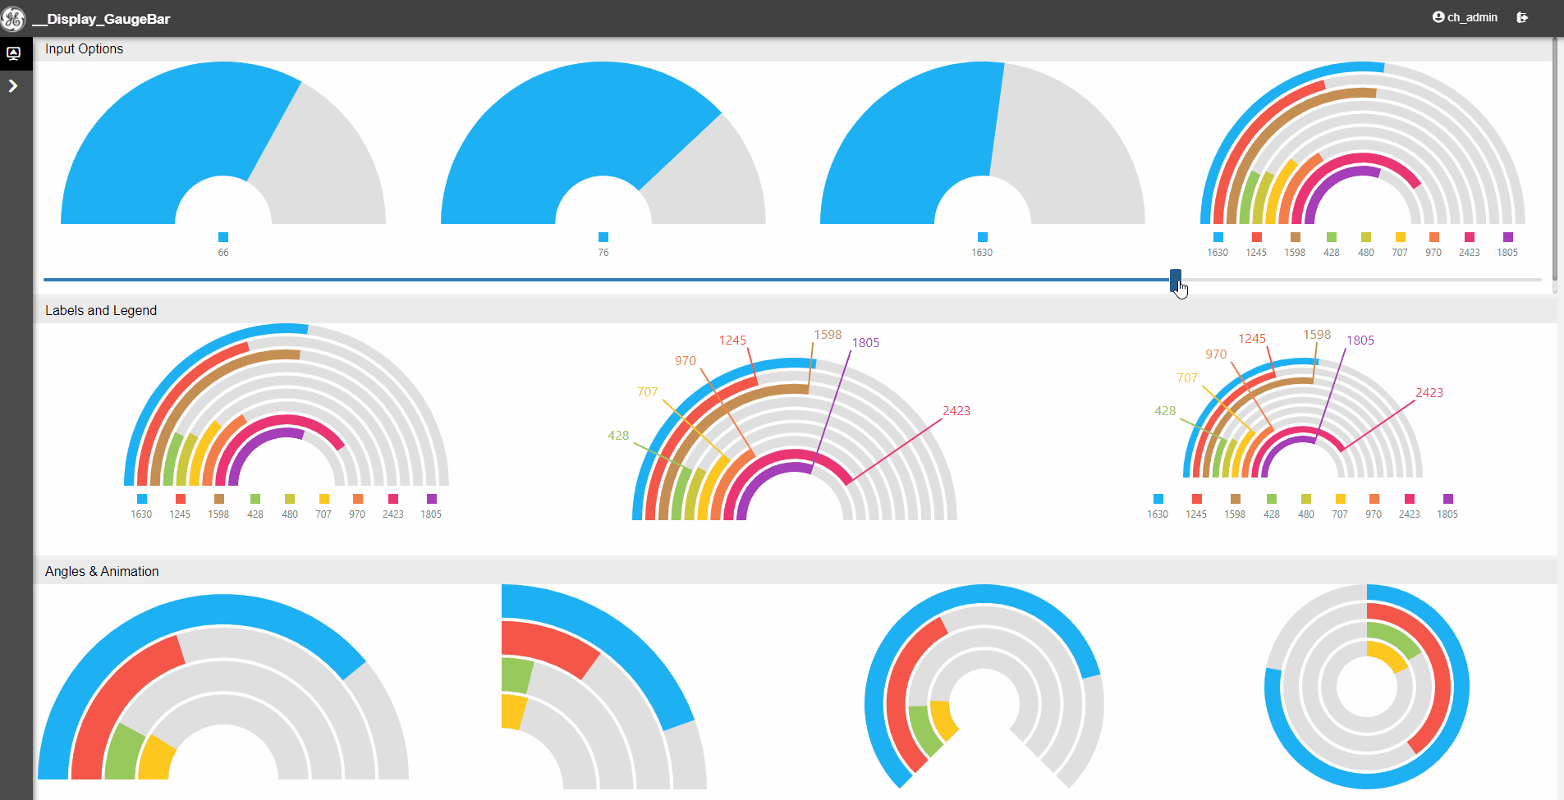
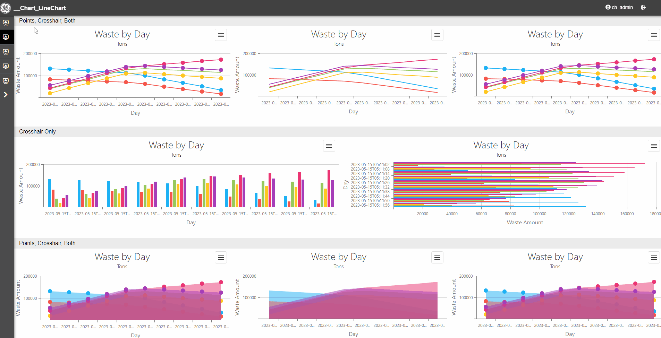
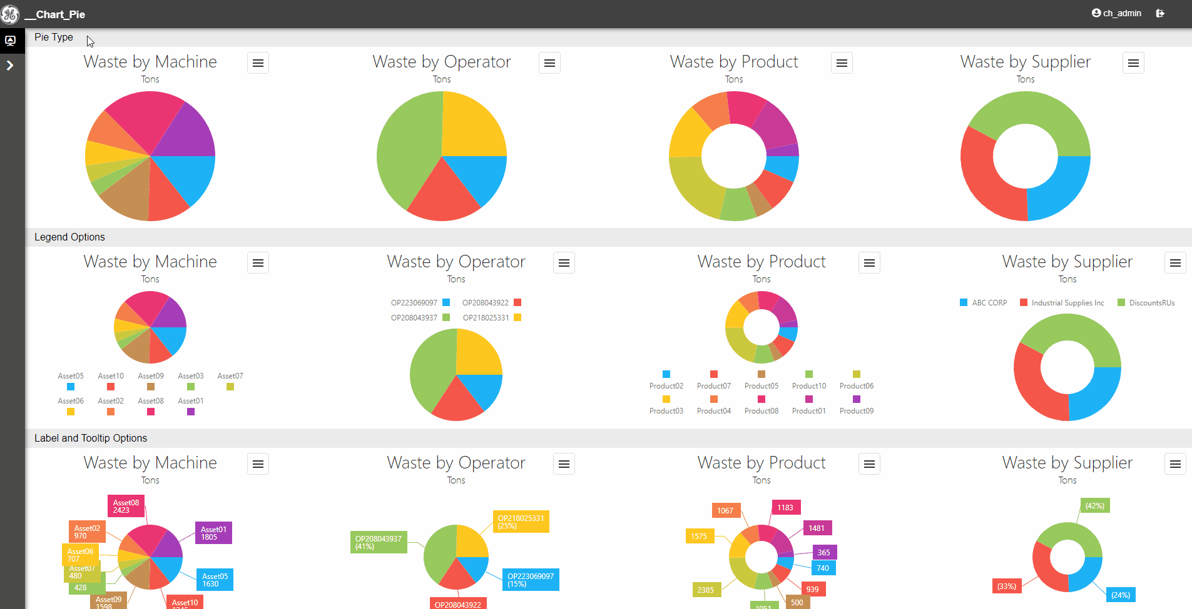
Operations Hub Enablement Content
Widget Tutorials
20+ videos covering a variety of widgets
Learn the ins and of input widgets, display widgets, and charts
Covers basics like getting started and data source options
Walk through an exploration of most widget features
Check back in for additional content!

Slide 58
Proficy Operations hUB 2025 and Beyond

Slide 59
Proficy Operations Hub - 2024 Cloud and 2025
Cloud and
& HA Support
Extensibility
HMI
MES
High Availability
Cloud – Support for SaaS Smart Factory environments
Zero Downtime Upgrade
Cloud – Support for SaaS Smart Factory environments
Scripting
Ability to define customized data by utilizing existing data sources, numeric constants, math functions, and math operations through a free-form scripting interface
Enhanced Data Binding
Ability to bind widgets using direct data references. Simplified page data management.
GraphQL Connector
Ability to connect to and interact with GraphQL data sources, including the new Plant Applications GraphQL API.
+ Selection of Tech Debt, UX Debt, Critical Requests
Notes:
* Zero Downtime Upgrade – Feasibility investigation. To be realized for the upgrade following 2024.
** May trail 2024 release/not tied to date directly
Also includes selection of critical customer request

Slide 60
Simplified Data Binding
When building screens, users will have the ability to refer to tag and model data directly for each widget, instead of referring to more abstract concepts such as queries or query output fields.
Drag and Drop integration - User confirms simple data settings after drop
Users can browse for tag directly from widget details
Users can directly see what data is bound to the widget, instead of having to trace back to the query and find the tag input field.
1
2
3
Pages are easier to build, debug and maintain

Slide 61
Scripting
Users will have the ability to customize data and visualizations through a free-form scripting interface. They will be able to perform common data manipulation tasks such as:
Selecting portions of a data set
Joining data from multiple sources
Formatting of data
Performing calculations on large data sets
Data validation
For-each iteration
Searching, sorting, and filtering
Extend Operations Hub for use in scenarios previously out of reach

Slide 62
Types of Scripting
Operations Hub 2025
Application Based Scripting
Plant floor manager wants a UI that has a filtered set of workorders. When a work order is selected, the details for the work order are presented to the user, as well as a document for that work order.
Manager wants to understand the overall Risk assessment, which is comprised of a contribution from two weighted tags. Manager can change contribution weights and rerun the script with the new values.
Event Based Scripting
Business wishes to track the total flow through each of three pumps throughout the day. Every day at 7:00AM, we need to write the current total to a reporting tag for yesterday’s flow, then reset the totalizer for the new day.
Business wishes to track the temperature of a refrigeration unit throughout the day. When the temperature exceeds 37 degrees, a new "HighTempEvent" record is created. User monitoring screen can see if there are any recent high temperature events.
Post Operations Hub 2025

Slide 63
Extend proficy® to gain sustainability insights

Slide 64
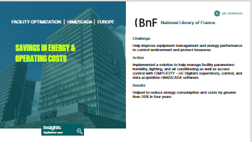
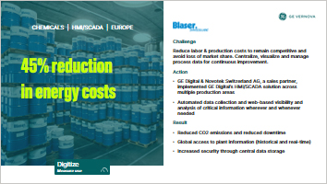
Customers are improving sustainability performance with Proficy capabilities today via customized solutions
© 2024 GE Vernova and/or its affiliates. All rights reserved.

Slide 65
Voice Of Customer … Driving home the need for a solution that optimizes productivity while operationalizing sustainability
Site-level usage lacks the operational context needed to truly optimize consumption.
We have ambitions to be Carbon Neutral, but no path to daily management of that goal.
We don’t have the data needed to comply with impending ESG regulations.
We lack the visibility to our utility usage that is needed for continuous improvement.
In my organization, Sustainability and Operational Excellence exist in siloes.
Our utility bills, especially our energy bills, are skyrocketing.
The people who influence how much we emit don’t have visibility to that data.

Slide 66
To realize synergies between profitability and sustainability, a new set of challenges must be solved
01
Operationalize environmental sustainability goals
02
Break siloes between Ops and Sustainability
03
Provide process context needed to truly optimize
Unlock daily management of Carbon Neutrality goals
Provide the data quality and granularity needed to act
Gain traceability to the plant floor on metrics such as Scope 1 & 2 emissions, water usage, etc.
Link sustainability metrics required by regulation to Ops performance management processes
Manage sustainability KPIs with the same rigor and routine as Quality or OEE
Optimize plants holistically – considering operational and sustainability performance
Attribute resource usage to products, assets, events
Benchmark against best demonstrated performance – for each process configuration
Determine the most impactful levers within operational constraints
Capabilities for world-class operational performance management
Extended to empower teams to actively manage sustainability KPIs
Notes:
Plant-floor context is critical to operationalizing manufacturers’ sustainability goals and optimizing their factories holistically. To capture synergies and recognize trade-offs, a new set of challenges must be solved.
Manufacturers need the ability to drive relevant sustainability KPIs down to the plant floor, with the granularity needed to act upon that data.
Manufacturers need to embed relevant sustainability KPIs into operational performance management routines and break siloes between these teams.
Manufacturers need to understand their KPIs in operational context to determine the most impactful levers within business constraints.
Beyond boosting resilience and mitigating risk, there are synergies in sustainability and operations objectives which improve profitability, too.

Slide 67
Progress toward active management of energy/GHGs and holistic optimization of the manufacturing operation
Global Visibility
Process Context
Optimization:
Asset, Meter, Event
Site Visibility
Site Visibility
Site Visibility
Production Context
Optimization:
Product, Part, Schedule
Organizational Context
Standardization:
Teams, Shifts, Behavior

Slide 68
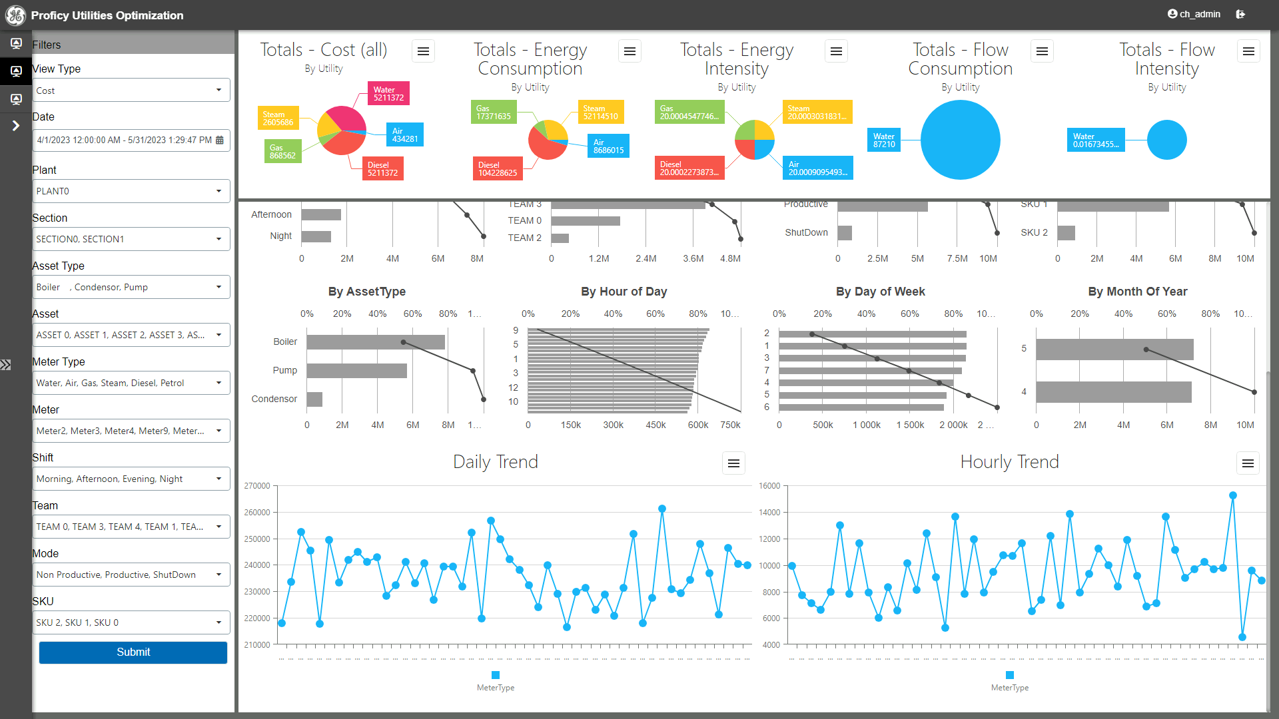
Fast time-to-value, advanced analytics, & persona-based visualization with Proficy for Sustainability Insights
Solution Architecture
Utility Data
Analytics Engine
Analysis
Monitoring
Prediction / Forecasting
Simulation
Optimization
Other OT Contextual Data
Visualization
Benchmark
Explain
Optimize
“Are we consuming too much?”
“Why are we consuming more than expected?”
“How can we reduce our footprint & our spend?”
Monitor actual usage vs. expected or targeted consumption in real-time
Leverage plant-floor context to understand how to improve resource efficiency
Execute on co-benefits which improve operational and sustainability KPIs
Correlate consumption in manufacturing context in real time
Reduce consumption & emissions at the process and production levels
Optimize usage and costs across production runs & sites
Production
Product SKU
Process area, Production line
Operational events
Shift, Time of Day, Weather conditions
Organizational
Enterprise, Business, Region
Site, Factory, Production team/crew
Environmental
Correlate consumption to Scope 1 & Scope 2 emissions, water use, energy intensity, etc.
Process Level
Find inefficient equipment
Find usage during non-production periods
Find unrecognized patterns, waste and improvement opportunities
Production Level
Map resource intensity of product portfolio
Find best practices; Standardize operations
Contextualize data to help manage sustainability KPIs from the plant floor
Production Runs
Optimize schedule for resource efficiency
Lower variability across multiple production runs
Curtail, shift production in high-cost periods
Sites & Supply Networks
Holistically optimize the production process accounting for cost & environmental impact
Optimize production plans using resource and emissions intensity as an input
Improve supply chain flexibility & resilience
Notes:
Finally, analytics tools can be layered on top to further optimize production environments and fine-tune the balance between operational and sustainability priorities. Tools like Proficy for Sustainability Insights help to benchmark consumption, explain variability or deviations in performance, and ultimately help to act to minimize resource consumption.

Slide 69
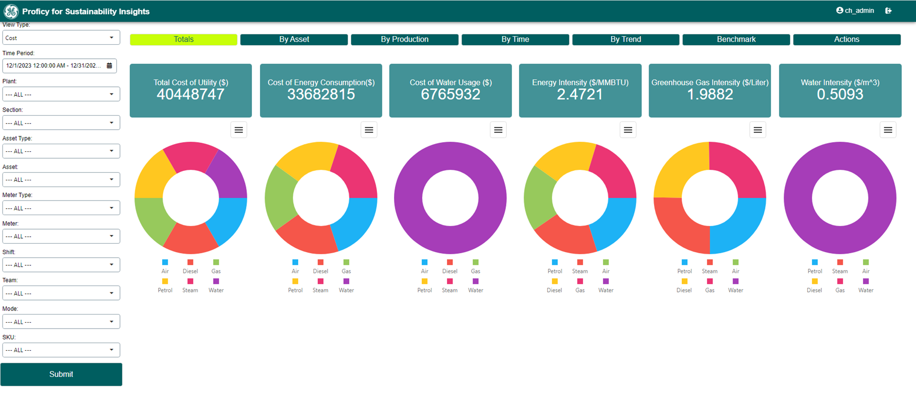
Instantly evaluate KPIs from production line to enterprise
02
Break siloes between Ops and Sustainability
Analyze by:
Cost
GHGs
Energy Use
Water Use
($/CO2e)

Slide 70
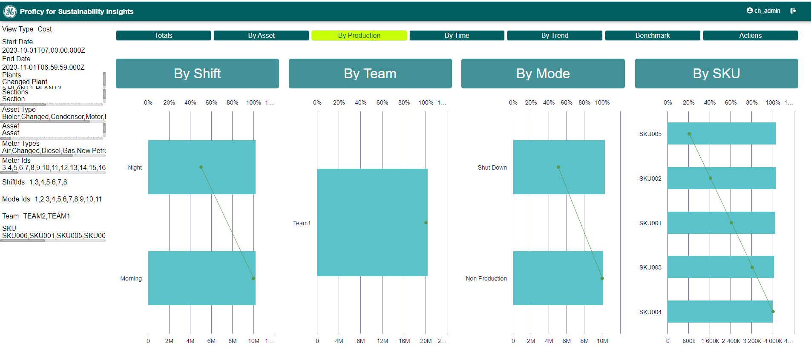
Assess performance and direct continuous improvement
03
Provide process context needed to truly optimize

Slide 71
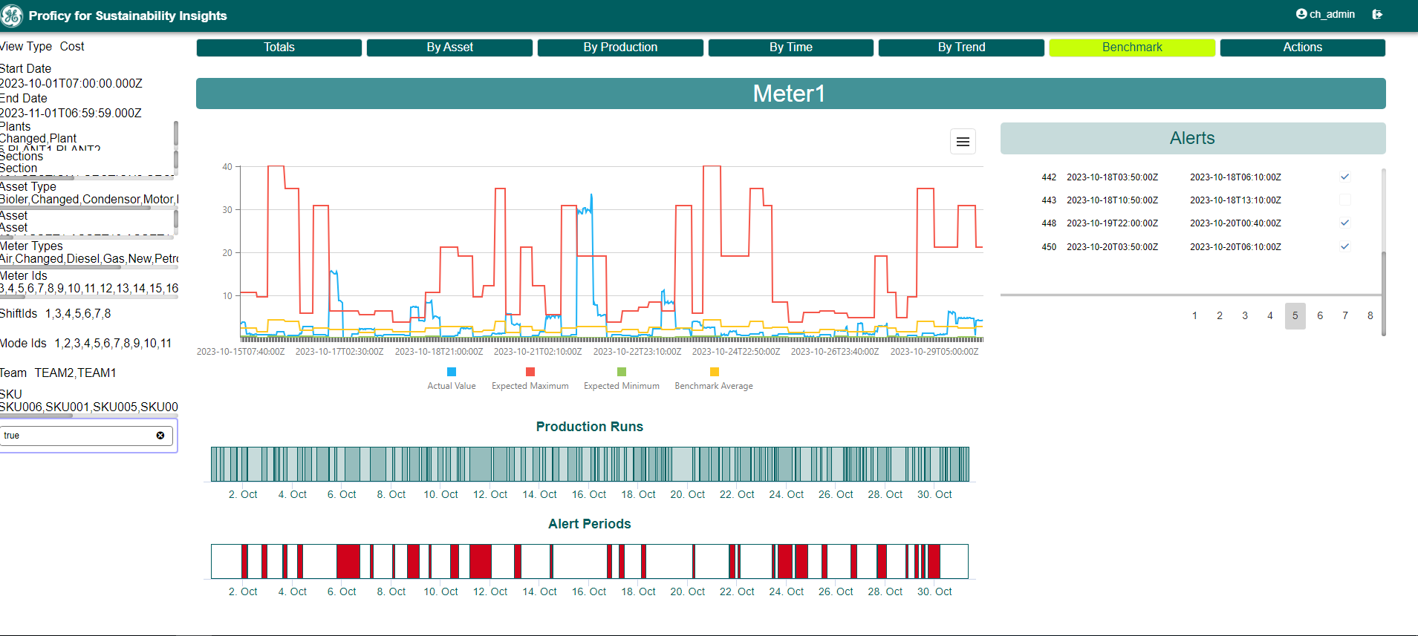
Analyze drivers of consumption, address alerts, and act
01
Operationalize environmental sustainability goals

Slide 72
Proficy for Sustainability Insights 2024 A path to action for holistic optimization and low-carbon production
DELIVER RESULTS FAST!
Out-of-the-box resource utilization analytics, data onboarding, persona-based visualization, control systems integration
Contextualized benchmarking
Evaluate current vs. expected performance considering each combination of site, SKU, and production mode
Operationalize reporting requirements
Dashboards for operations management aligned to regulatory disclosure standards on sustainability
BENEFITS
Real-time resource usage monitoring
Advisory analytics for active management & optimization
Persona-based UI for front-line and Ops leadership
Contextualized benchmarks
Out-of-the-box KPIs for Scope 1, Scope 2, water use
Check out the Demo Booth to see Sustainability Insights live!

